Slide 1
Offer the National DPP lifestyle change program to employees at your health care organization
Thank you for considering the National Diabetes Prevention Program (National DPP) lifestyle change program.
We understand there may be several people involved in your employee health and wellness program decision-making. So, we’ve created this presentation template to help facilitate your communication process.
Use this slide deck template to customize a presentation for your senior leaders. On the following slides, you’ll find several opportunities to tailor the business case based on your organization’s profile.
Be sure to populate the highlighted areas of the presentation with your own data.
We wish you great success in your efforts to prevent type 2 diabetes!

Slide 2
Targeted wellness for diabetes prevention
ADD YOUR LOGO HERE
What we can do to help our team and our bottom line

Slide 3
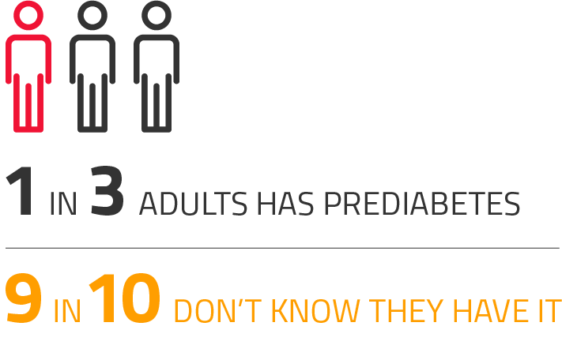
Prediabetes facts
30+ million Americans have diabetes. ¹
1 out of every 3 adults has prediabetes, and 90% do not even know it.¹
Prediabetes occurs when blood glucose levels are higher than normal, but have not reached the levels needed for a diagnosis of diabetes.
If prediabetes is not addressed, it may develop into type 2 diabetes.

Slide 4
<Organization Name>
Concern #1: Inflated medical costs
EMPLOYER IMPACT:
People with diabetes have medical expenses that are approximately 2.3 times higher than the medical expenses of people without diabetes.²
In the general population, the average total medical expense incurred by people with diabetes is $16,750 per year.²
Health insurance loss ratios
Health insurance premiums
Workers’ compensation medical costs
Workers compensation insurance premiums
Takeaway: We can help control health insurance and workers’ compensation insurance costs by preventing type 2 diabetes.

Slide 5
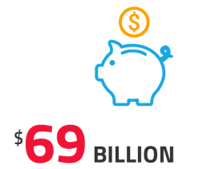
<Organization Name>
Concern #2: Lost productivity
Diabetes-related lost productivity costs the United States roughly $90 billion per year.² Employers experience lost productivity in many forms including:
Time off. Employees with diabetes may need to take time off work to deal with health issues.
Higher turnover rates. Employees with diabetes may need to stop working due to serious health complications and disability.
Reduced morale. A sick workforce is not as energized and productive as a healthy workforce.
2
Takeaway: We have a vested interest in our team’s health and welfare. Employees are with us for an average of <XX years>, making type 2 diabetes prevention a worthwhile investment.

Slide 6
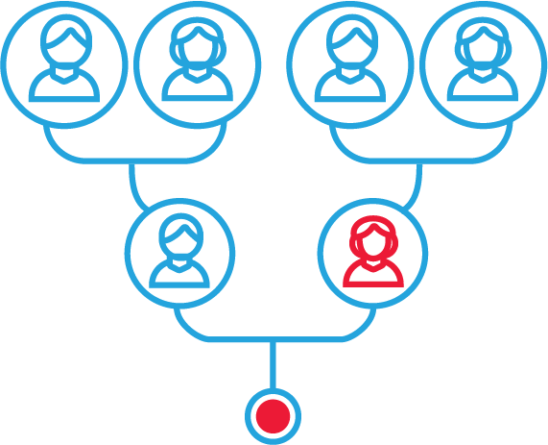
Potential prediabetes at <Organization’s Name>
Diabetes is a problem in the workforce. Employees are at risk for diabetes if they:
Are 40 years of age or older
Have a BMI that is categorized as overweight or obese
Have a history of gestational diabetes
Have a family history of type 2 diabetes
Have certain medical conditions like high blood pressure
Have a sedentary lifestyle
Many of our employees could have prediabetes and be at risk for type 2 diabetes.
Fortunately, we can help!

Slide 7
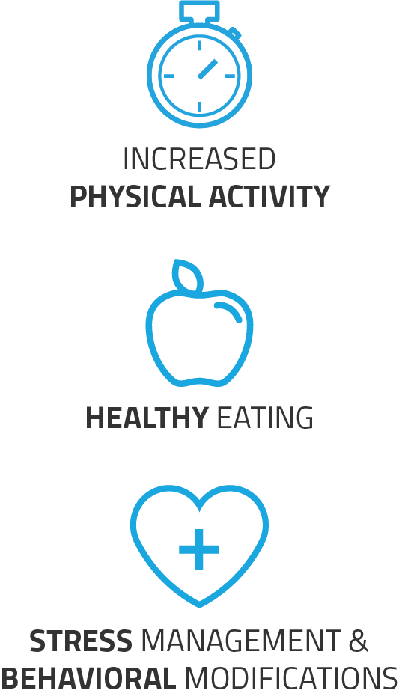
How <Organization Name> can make a difference
We can make a big difference by offering the National Diabetes Prevention Program (National DPP) lifestyle change program as a covered benefit.
Why?
Aligns with our corporate wellness goals
Supports the health and longevity of our team
Generates positive ROI by controlling medical costs and lost productivity
While focus is type 2 diabetes prevention, the program may align to broader health and wellness strategies
How?
Employees are invited to participate in program eligibility screening
Those who qualify receive plan components as a covered health benefit
We can also offer this plan to spouses and children over 18 if we choose
Program delivery can be customized with onsite, off-site or online course options
We can name and promote the program in the way that fits best with our corporate culture
We can also incentivize participation, if we wish

Slide 8
What is the National DPP lifestyle change program?
The National DPP lifestyle change program is an intensive lifestyle change program that helps participants make healthy lifestyle changes to reduce their risk of type 2 diabetes.
This evidence-based program is delivered by a trained lifestyle coach and includes 16 weekly sessions followed by monthly maintenance sessions.
The goal for participants is a 5 percent body weight loss and 150 minutes of weekly physical activity.
The CDC provides oversight and quality assurance of all National DPP lifestyle change programs.

Slide 9
The business case
An investment to support the National DPP lifestyle change program is all that’s needed to help reduce the occurrence of type 2 diabetes.
Over 3 years, we could expect to see:
A 1 to 2% decrease in absenteeism and lost productivity³
PROJECTED MEDICAL COST SAVINGS: ORGANIZATION NAME
Using the calculator at ama-roi-calculator.appspot.com/, we have projected a potential savings of:
$XXXX over 3 years
Projections based on XX employees.
Individual results vary depending on the cost of program participation, the prevalence of prediabetes, the enrollment rate and the completion rate. The above results were calculated based on common ranges.
A possible savings of approximately $8,000 in medical expenditures per each participant who does not progress to type 2 diabetes⁴
It is particularly cost effective when you consider that, on average, those with well established/diagnosed diabetes incur $16,750 in total medical expenditures each year. ²

Slide 10
Program overview
Description of the National DPP lifestyle change program
Add information - How would the program be delivered in your organization – onsite classes, offsite through community partners or online (or a combo approach)?
Eligible employees
Add information - How will you identify or target eligible participants for the program?
Communication and messaging
Add information - How will you name and market the program to encourage participation?
Registration process
Add information - How will your employees register to participate in the program?
[Optional] Feedback loop
Add information – Will you incorporate bi-directional feedback on patient progress back to the employee’s PCP? If so, how?
Evaluation process
Add information – How will you evaluate the success of your diabetes prevention strategy?
Program launch
When will you roll out the program? How much time is needed to set it up?

Slide 11
Questions / Discussion

Slide 12
Sources
Centers for Disease Control and Prevention, National Diabetes Statistics Report, 2017 Estimates of Diabetes and Its Burden in the United States. Atlanta GA 2017 https://www.cdc.gov/diabetes/pdfs/data/statistics/national-diabetes-statistics-report.pdf
American Diabetes Association. "Economic costs of diabetes in the US in 2017." Diabetes care 41.5 (2018): 917-928.
Dall, Timothy M., et al. "Value of lifestyle intervention to prevent diabetes and sequelae." American journal of preventive medicine 48.3 (2015): 271-280.
Khan T, Tsipas S, Wozniak GD. Medical care expenditures for individuals with prediabetes: The potential cost savings in reducing the risk of developing diabetes. Popul Health Manag. 2017. doi:10.1089/pop.2016.0134

